Slide 1
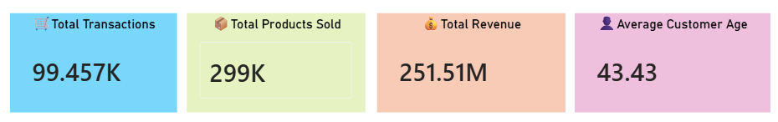
Customer Data Analysis
Charts (screenshots)
Tools Used : Microsoft Power BI

Slide 2
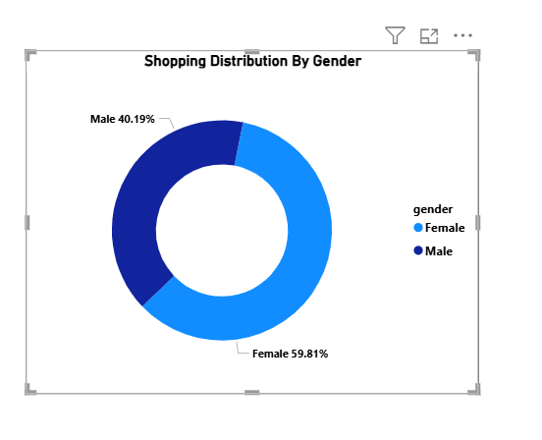
1. Shopping Distribution By Gender

Slide 3
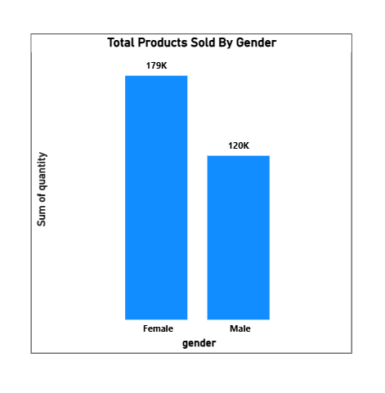
2. Total Products Sold By Gender

Slide 4
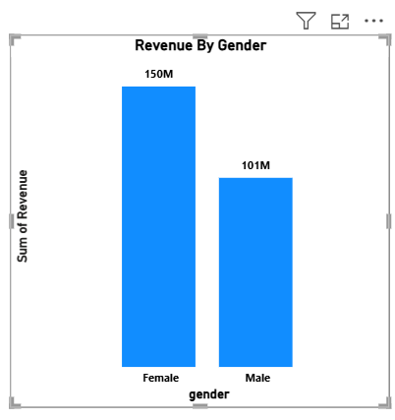
3.Revenue By Gender

Slide 5
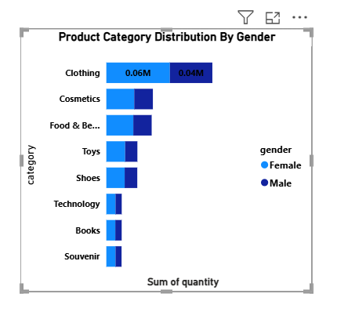
4.Product Category Distribution By Gender

Slide 6
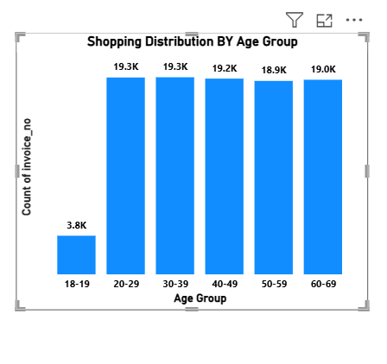
5.Shopping Distribution By Age Gender

Slide 7
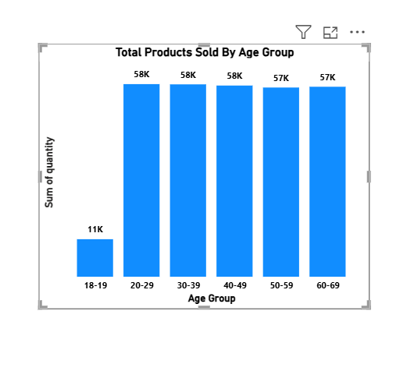
6.Total Products Sold By Age Group

Slide 8
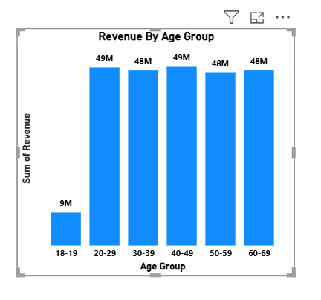
7.Revenue By Age Group

Slide 9
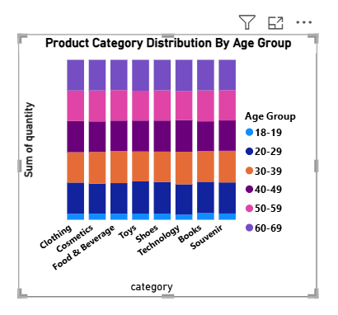
8.Product Category Distribution By Age Group

Slide 10
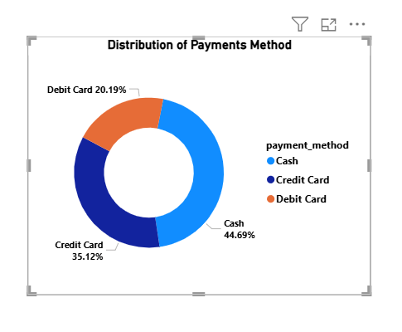
9.Distribution of Payments Method

Slide 11
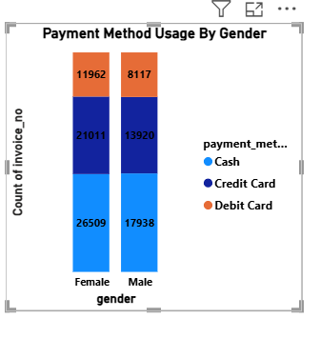
10.Payment Method Usage By Gender

Slide 12
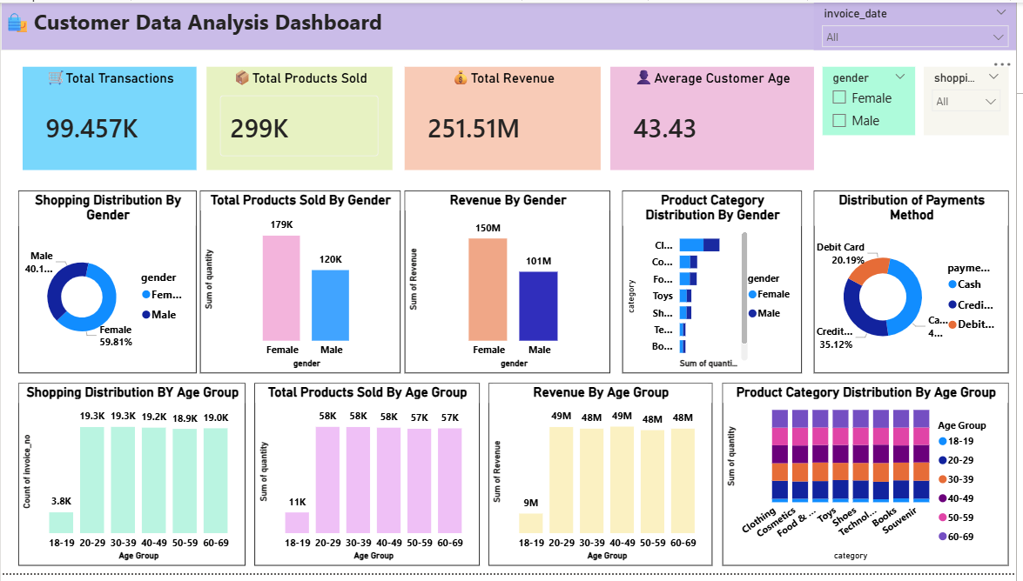
11.Customer Data Analysis Dashboard

